Slide 1
IAB Ireland / Enterprise Ireland SME Masterclass:
Digital Lead Generation
22 October 2020

Slide 2
Damian Lynch
Head of Sales,
Google Customer Solutions, Ireland

Slide 3
What we’ll cover today
1
Defining what a quality lead is
How to find those leads
Keep it simple to drive scale
2
3
Notes:
The 3 Topics I’ll be covering today are:
But before we get stuck into that let’s just take a moment to understand the seismic shift happen to people & businesses since Covid hit [CLICK]

Slide 4
Market Context
“There are decades where nothing happens; and there are weeks where decades happen”
38%
36%
Notes:
Covid19 has change consumer & business behaviour & things won’t go back to the way they were
Globally the B2B sector has seen a 38% increase in demand due to the shift to digital. Ireland is inline with this shift seeing 36% increase in demand

Slide 5
21%
$1.2M
Wasted Investment due to poor data quality
Resulting in an average annual loss for a midsize company
Notes:
Source: Forrester: Why Marketers Can’t Ignore Data Quality: July 2019 - link
Data quality affects your bottom line. With an estimated 21% of marketing dollars wasted based on data quality, for a small sized business, this translates to $1.2M in lost revenue.

Slide 6
#1 priority for lead generation businesses
Improving the
quality of leads
Notes:
For businesses focused on lead generation - lead quality continues to be THE top priority to fuel growth. And the primary driver of quality?... intent - because when you understand customer intent, then you have the ability to drive quality.
Source: LeadCrunch 2019 via eMarketer [link]

Slide 7
To understand the quality of your leads you need to define what a quality lead is
Step 1
Notes:
The question I always ask my partners I work with is; Are you & your teams crystal clear on what a quality lead is and how valuable it is to your business
Let’s start with Step 1: Defining quality & setting you up for sucess

Slide 8
Let’s start the most common mistake we see today
100
Leads
40
Qualified Leads
10
Sales
Average B2B company
Unclear on lead quality
Increase volume
Is this good?
Unclear measurement signals

Slide 9
Let’s try that again focusing on quality
After focusing and improving lead quality...
100
Leads
60
Qualified Leads
30
Sales
+3x
Some good quality leads
Increase volume
More good quality leads
Better measurement signals
Notes:
The foundation for better quality leads starts w/ measurement.
A case that we often see, if we are focussing on signals of quantity rather than quality, is this: we invest more, we get more leads, but most of them turn out to be poor, so our actual ROI goes down
Now if we have a better measurement signal, we can actually balance quantity and quality, and get more volume at a better ROI
This may seem like a simple, logical slide; but you’d be surprised at how often something other than measurement gets the blame for poor performance, when really we aren’t feeding it the right signals ((e.g. smart bidding or machine learning)
The signal we want in this case is a signal for what is a quality lead

Slide 10
Measurement is key but what should you measure?
Engaged visitors
Online
Conversion tracking
Pages visited
Newsletter sign-ups
Brochure downloads
Leads
Phone calls
Form submissions
Qualified leads
Offline
Conversion tracking
Marketing / Sales qualified leads
Buyers
Closed deal
Notes:
To define what a quality lead looks like, start by defining your business objectives and laying the groundwork
Measurement (or conversion tracking which is the measurement currency in digital marketing) lays the foundation for everything else when it comes to digital marketing.
Your measurement informs the decisions that you make (whether it be budget allocation, campaign and bid optimisation, or even choosing what keywords to target). Classic case of garbage in, garbage out - you want to be making decisions on the best data possible.
There is a host of different things you can measure, so let’s look at a typical lead gen consumer path and the types of things we can measure
Most lead gen advertisers today are focussing their measurement on lead form submissions on their website (so looking at quantity of leads, instead of quality of leads). In other words, they don’t have visibility into what happens once a consumer leaves their website. This means most advertisers are flying completely blind when it comes to understanding which marketing efforts (which campaigns) are actually working and where they should be investing more and where they should be investing less.

Slide 11
Not all conversions are created equal
Micro:
A micro conversion is also an important action, but it does not immediately contribute to your bottom line.
Macro:
A macro conversion occurs when someone completes the primary action that’s important to your business, i.e. contributes to the bottom line.
Example: Newsletter sign-up, time spent on website, video play, etc.
Example:
Online purchases, lead submissions, etc.
Notes:
For some businesses, it makes sense to track more than one conversion - and that’s totally fine. If there are numerous valuable actions someone can take on a client’s website, we ideally want to track them all. But not all conversions are created equal, so we prompt you to think of each conversion as falling into one of two buckets: Macro or Micro conversions. [read the definitions].
We encourage you to track both macro and micro conversions, but to ensure that you’re only optimizing toward those most important actions, or your macro conversions.
An example of when you might do this is with a client that has a longer sales cycle, like in higher education. While the most valuable action for a university might be someone applying to their program, since for many people there’s a lot of research that takes place before applying, they might also choose to track actions like brochure downloads, sign ups for tours, and site engagement. In this example, it’s most important for this client to optimize for applications, their macro conversion, as all of these additional actions are just leading indicators of someone ultimately submitting an application. We could, however, optimize for the micro conversions if there isn’t a significant volume of applications for us to optimize based off of.
I think it is fine to measure both. But it is critical for a seller to understand that a page view should not have the same value as a purchase.
It is important that the micro conversions are valued less than the macro conversions. And in general, in some cases it makes sense for a customer to only optimize towards the macro conversions (ie, include in the conversions column). But not all customers have solid macro conversions they can easily track (very long sales cycle and no CRM system). Therefore we don't want to be too prescriptive, but want this idea to be known. We don't want sellers just tracking whatever to get points, and then we see Smart Bidding churn.

Slide 12
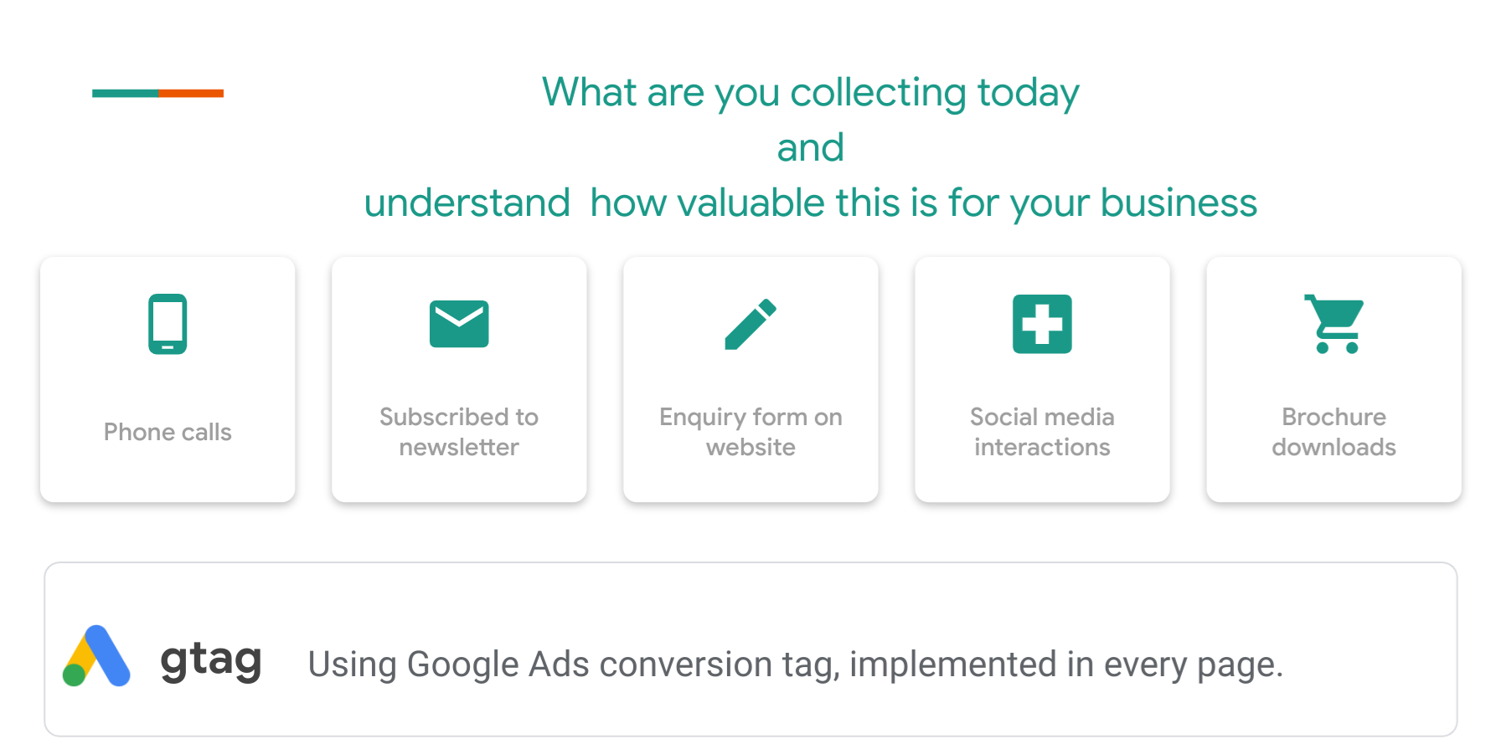

Slide 13
Zen Business

Slide 14
Now you’ve defined quality, who should you target
Step 2
Notes:
Now that you have defined quality and are sharing those signals back - use these Google solutions to action and drive business impact.

Slide 15
Some questions to consider
Who is my target audience?
What are their interests & behaviors?
What are they searching for?
What are they watching online?
Notes:
Are you clear on who is your target audience and how you are going to try and target them?

Slide 16
Your target audience will fall into 1 of 3 segments with search being able to target all
Customer Segment
Google Search
People who don’t know your business
Awareness
People who’ve interacted with your business but not converted to a sale
Consideration
Existing customers / leads
Action & Advocacy
Notes:
Search plays a crucial role in a users online journey and engaging with the right user at the right time is more important than ever for marketers. Consumers will continue to be more likely to engage w/content that they are passionate about, personal, and useful. Google’s Search audience solutions deliver proven results from increasing awareness though to driving action to make your ads more relevant and capture the attention of your most valuable audience.

Slide 17
5.6 billion
searches happen on Google each day. Powered by user intent

Slide 18
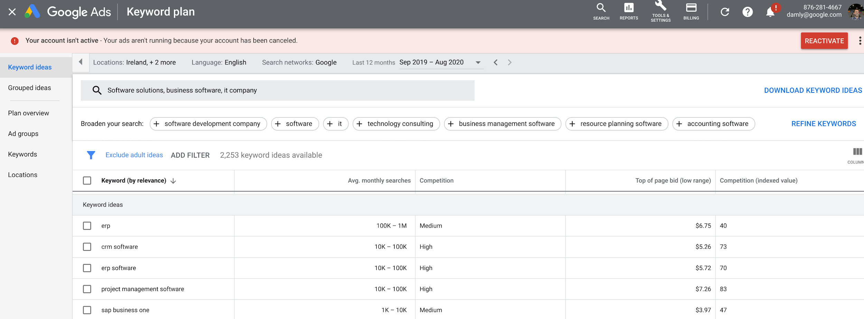
Getting started with sizing the opportunity using keyword Planner

Slide 19
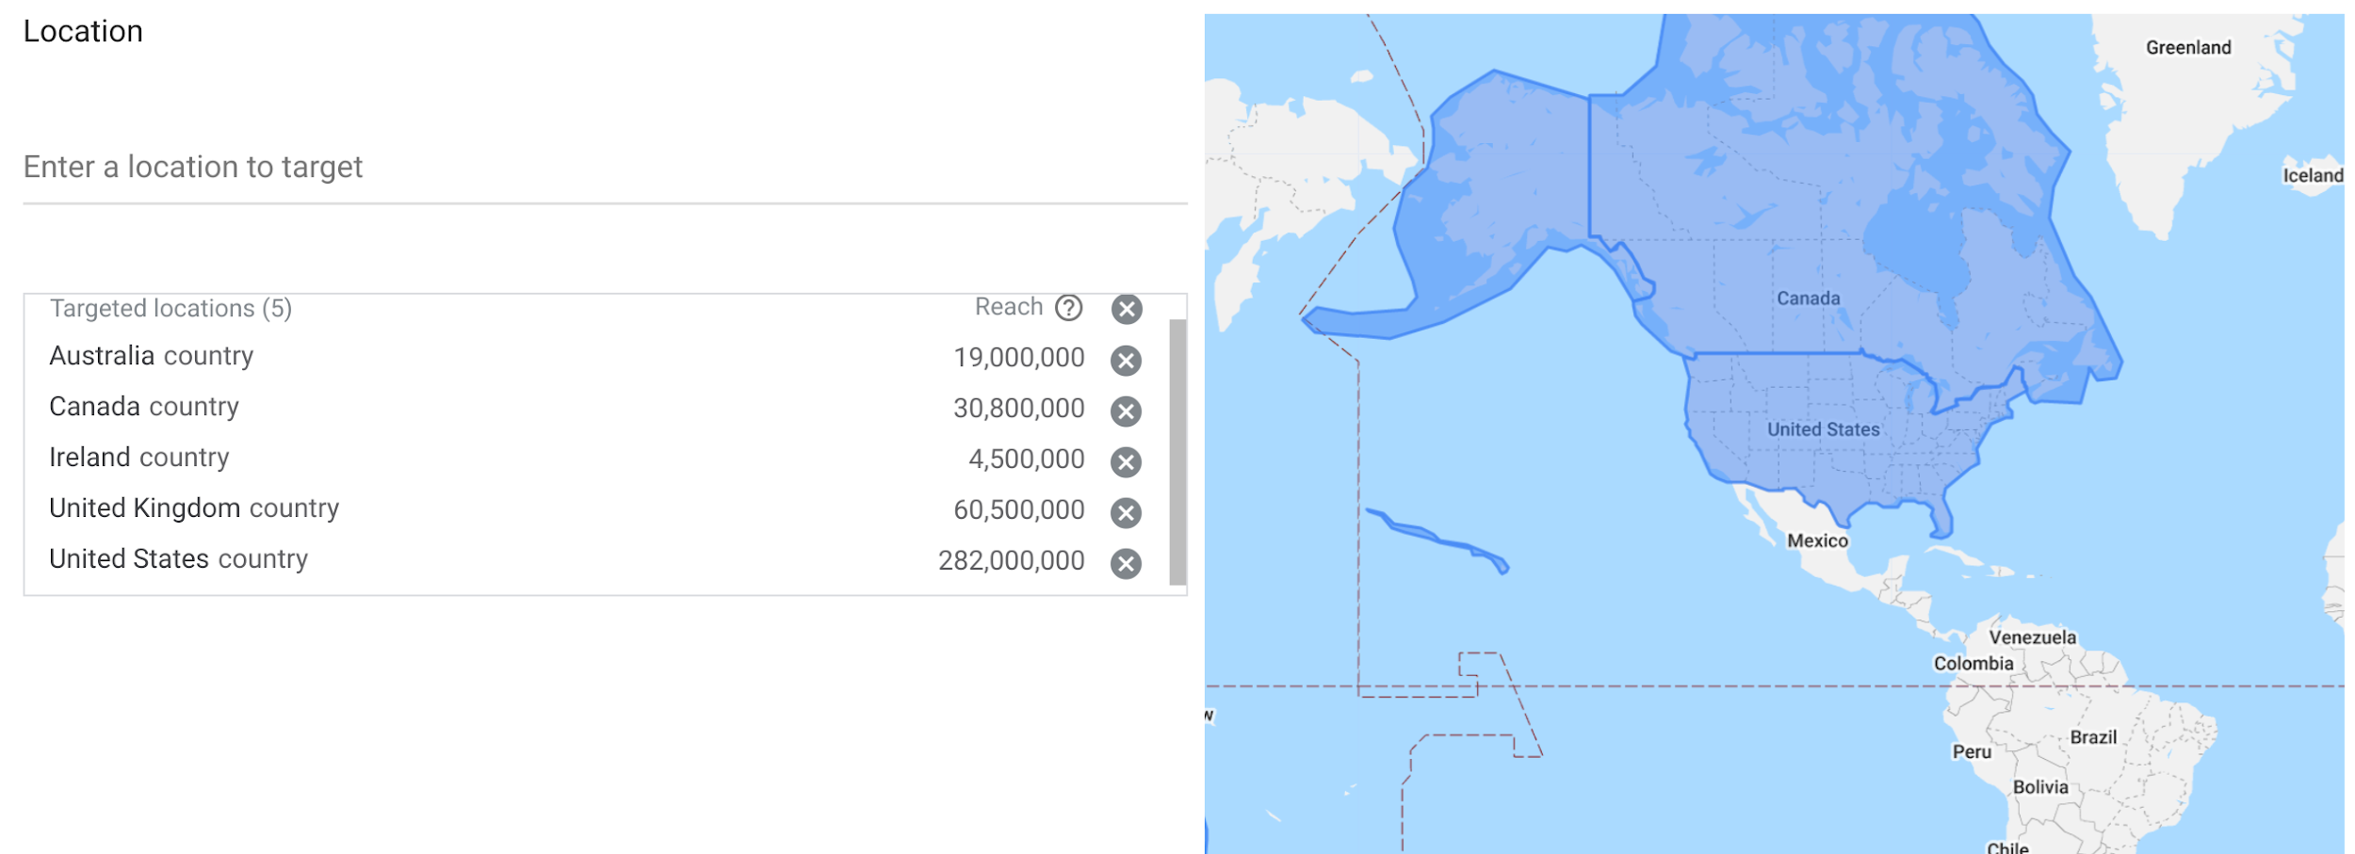
Irish business starting to move global with search

Slide 20
Define your goal & automate your marketing
Smart Bidding
+

Slide 21
Setting the right value for a lead while using automated solution gusto were able to accelerate their growth
San Francisco, CA, U.S. • gusto.com
Gusto increases ROAS by 73% with offline conversion tracking and Smart Bidding
+127%
+73%
conversion rate
return on ad spend
Google Smart Bidding took our Search program to the next level. With such strong ROAS, we’re able to reach more high-potential customers and provide valuable services during moments that matter.”
- Adam Treboutat, Growth Marketing Lead
Notes:
Case study example 1. Started with a data audit to understand the life time value of this customer. They feed the data back into their Google account which saw incredible results.
The challenge
Gusto is a modern, online people platform that helps small businesses take care of their teams. To maximize high-value conversions and increase their return on ad spend (ROAS), they incorporated their lifetime value (LTV) model into a third-party automated bidding solution, but weren’t seeing significant results.
The approach
Gusto began importing LTV into Google Ads through offline conversion tracking (OCT), enabling them to attribute projected revenue to clicks in Google Ads. Then, they unlocked the full value of data integration and automation through Smart Bidding. Because Gusto was already using a third-party bidding solution, they chose drafts and experiments to split budgets on select campaigns into control and test groups, incorporating LTV data with Google’s machine learning.
The results
After a six-week test period, the campaigns drove a 127% increase in conversion rate, resulting in a 45% improvement to ROAS. Gusto then migrated all campaigns to Smart Bidding, which drove a 73% increase in non-brand campaign ROAS and +21% ROAS in branded campaigns.

Slide 22
Keep it simple
Step 3

Slide 23
1 second delay in load time……..
38%
of smartphone users have screamed at, cursed at,
or thrown their phones when pages take too long to load
8.3%
3.5%
9.4%
Increase in bounce rate
Decrease in conversion rate
Decrease in page views

Slide 24
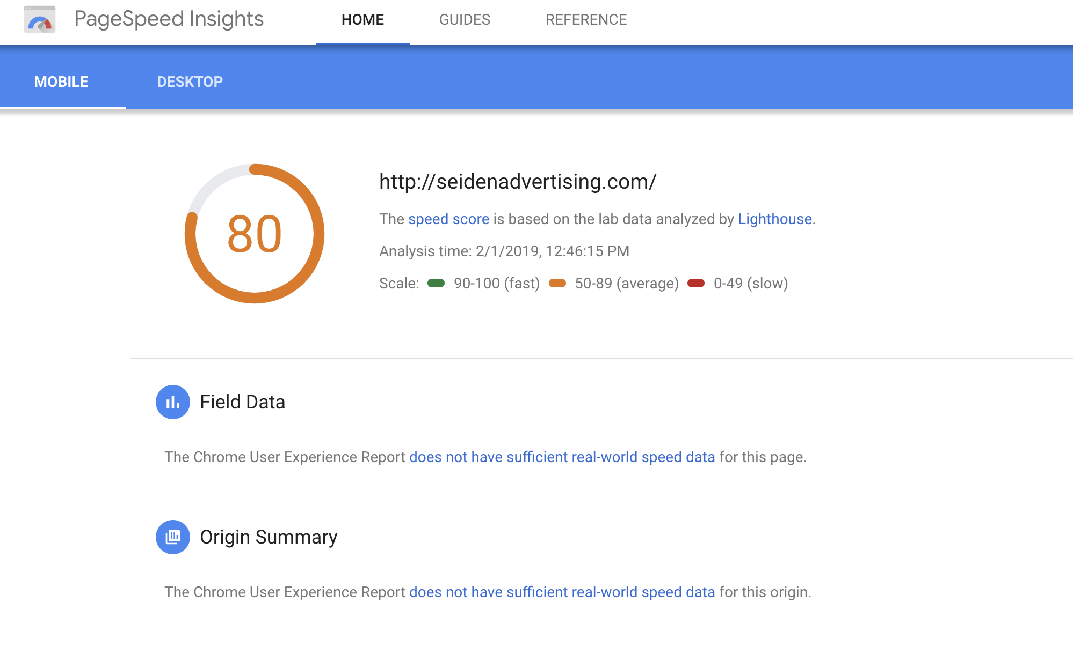
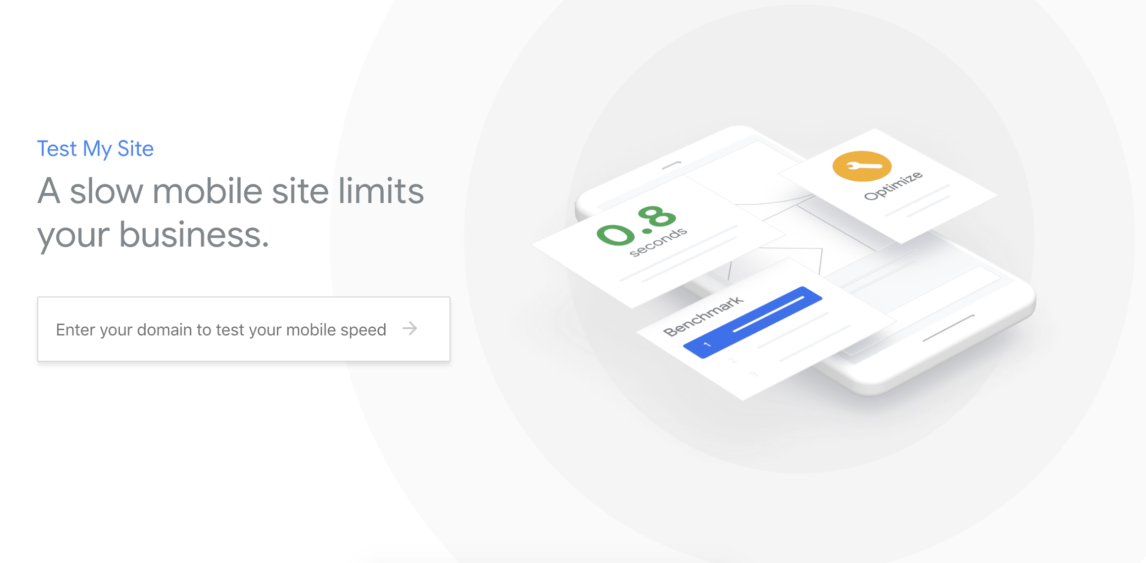
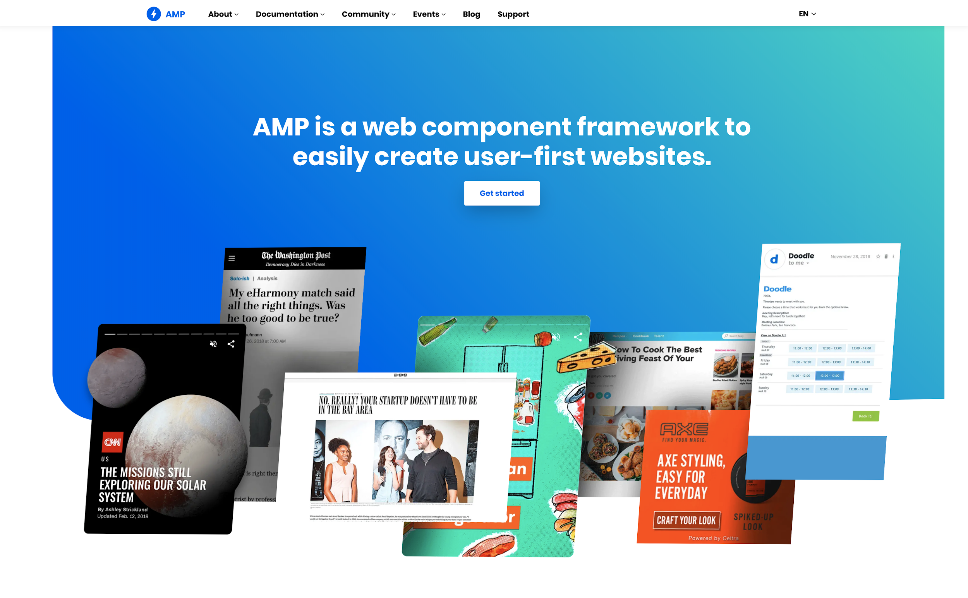
3 Ways to Help Mobile Site Performance
PageSpeed Insights
developers.google.com/speed/pagespeed/insights/
0-100 mobile performance score
Concrete suggestions to implement mSite improvements
[NEW] TestMySite
thinkwithgoogle.com/feature/testmysite
Compare your speed to competitors using real user data
Evaluate how much a slow site hurts your business
Accelerated Mobile Pages
amp.dev
Build your landing pages so they’ll load in <1s
Ask your rep how Google can provide you with your first AMPed landing page

Slide 25
Typing on mobile is Hard

Slide 26
73%
of people who start filling out a web form abandon it after only completing the first few fields
Source: Leadgen UX playbook

Slide 27
Keep your best-quality prospects engaged through a great user experience, by doing:
What
Placing a clear
call-to-action above the fold
Call-to-action
Your future starts today.
Learn more about our courses and choose the one that is right for you.
Why
Stating a clear
value proposition
Contact
Talk to our admission team
Why enroll today?
Ranked top 30 university in '18
Flexible online and onsite schedule
90% recent graduates debt-free
How
Value Prop
Offering an easy
path to contact (e.g. form/call)
Above the Fold

Slide 28
Key Takeaways
1
Start by defining what is a quality lead is for you
Understand your target audience
Keep it simple at scale
2
3

Slide 29
Thank you.

Slide 30
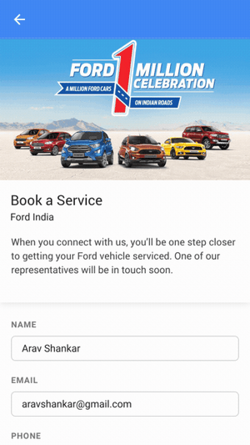
Make it easy to express interest: Lead Form Ads
2 clicks & 3 seconds
Efficiently find and engage with high-intent potential customers.
Lead Form Ads are best for driving quality leads.

Slide 31
How it works
01
02
03
04
05
User clicks on an ad and arrives on the site.
User becomes a lead (by submitting a form).
Unique Identifier (GCLID) is passed and stored along with user’s details in advertiser’s database/CRM.
The lead/sale is closed offline. Lead status changed in CRM.
CRM output is formatted correctly.
Data is uploaded.
Ad
GCLID
748596123
GCLID
748596123
Notes:
A bit more about how Offline Conversion Tracking works - it may seem a little complex, but the concept is actually very simple
Mention that this is also available for tracking calls
Not only the number of sales, but also the value that sales represents to you
Hear from advertiser who has used offline conversion tracking very successfully
-----
Google Ads Offline Conversion Tracking is integrated with reporting/bidding and will allow you to optimize for more quality leads. It works like this:
A user clicks on your ad to arrive on your site. We provide you with a Google Click ID (GCLID), an alphanumeric string that identifies a click on an ad.
This prospective user fills out your form or calls your business. The GCLID is then passed and stored into your database.
The lead information is then passed to and stored in your CRM.
Sale is made offline - Congrats!
You can then upload the GCLID conversion type and date into Google Ads. This then becomes a Google Ads conversion.
You then have a complete picture of how your online ads generate offline value.

Slide 32
Measure offline leads:
Offline Conversion Tracking
Measure offline or otherwise untrackable conversion events up to 90 days after the click.
Import these events directly into Google Ads.
Gain a deeper and more granular understanding of how each online click drives offline actions through better reporting.
Distinguish between clicks and queries that lead to high vs. low quality leads.
Use this intelligence to unlock better bid optimization.
Notes:
Make sure you integrate your CRM efforts with Offline Conversion Tracking
Our solution is called Offline Conversion Tracking, which offers the ability to gain a deeper understanding of offline actions (such as sales, registrations, etc)…

Slide 33
Redefining quality means aligning on the right measurement
Engaged visitors
Online
Conversion tracking
Pages visited
Newsletter sign-ups
Brochure downloads
Leads
Phone calls
Form submissions
Qualified leads
Offline
Conversion tracking
Marketing / Sales qualified leads
Buyers
Closed deal

Slide 34
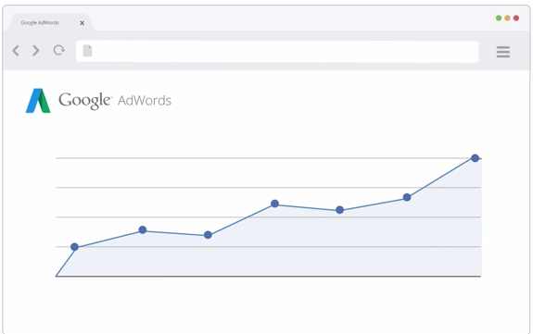
Make it easy for prospects to connect live instantly
Calls from Ads
Calls from Website
Website Call Conversion Tracking
See how effectively your ads lead to phone calls from your website. Now available with a new simplified implementation process! - Learn More
Call-only Ads
Call-only ads only appear on devices that can make phone calls, and the ads are designed to encourage people to call. These are a great option for advertisers who are primarily looking to drive calls and/or do not have a mobile optimized website - Learn More
877-555-5555
Call Extensions
Call extensions let you add phone numbers to your ads, which can significantly increase clickthrough rates. When your call extensions show on mobile, people can tap to call your business directly. - Learn More
877-555-5555

Slide 35
1 second delay in load time...
PageSpeed Insights
developers.google.com/speed/pagespeed/insights/
0-100 mobile performance score
Concrete suggestions to implement mSite improvements
[NEW] TestMySite
thinkwithgoogle.com/feature/testmysite
Compare your speed to competitors using real user data
Evaluate how much a slow site hurts your business
Accelerated Mobile Pages
amp.dev
Build your landing pages so they’ll load in <1s
Ask your rep how Google can provide you with your first AMPed landing page

Slide 36
Delight customers
How can we work on the user experience?
Speed & Performance
Design & Functionality

